Slide 1
Foundations of Economics

Slide 2
Foundations of Economics
How People Make decisions?
Principle 1: People face TRADE OFF
Principle 2: The cost of something is what you give up to get it- OPPORTUNITY COST
Principle 3: Rational people think at MARGIN
Principle 4: People Respond to INCENTIVES
How People Interact?
Principle 5: Trade can make everyone better off
Principle 6: Markets are usually a good way to organize economic activity
Principle 7: Government can sometimes improve market outcomes.

Slide 3
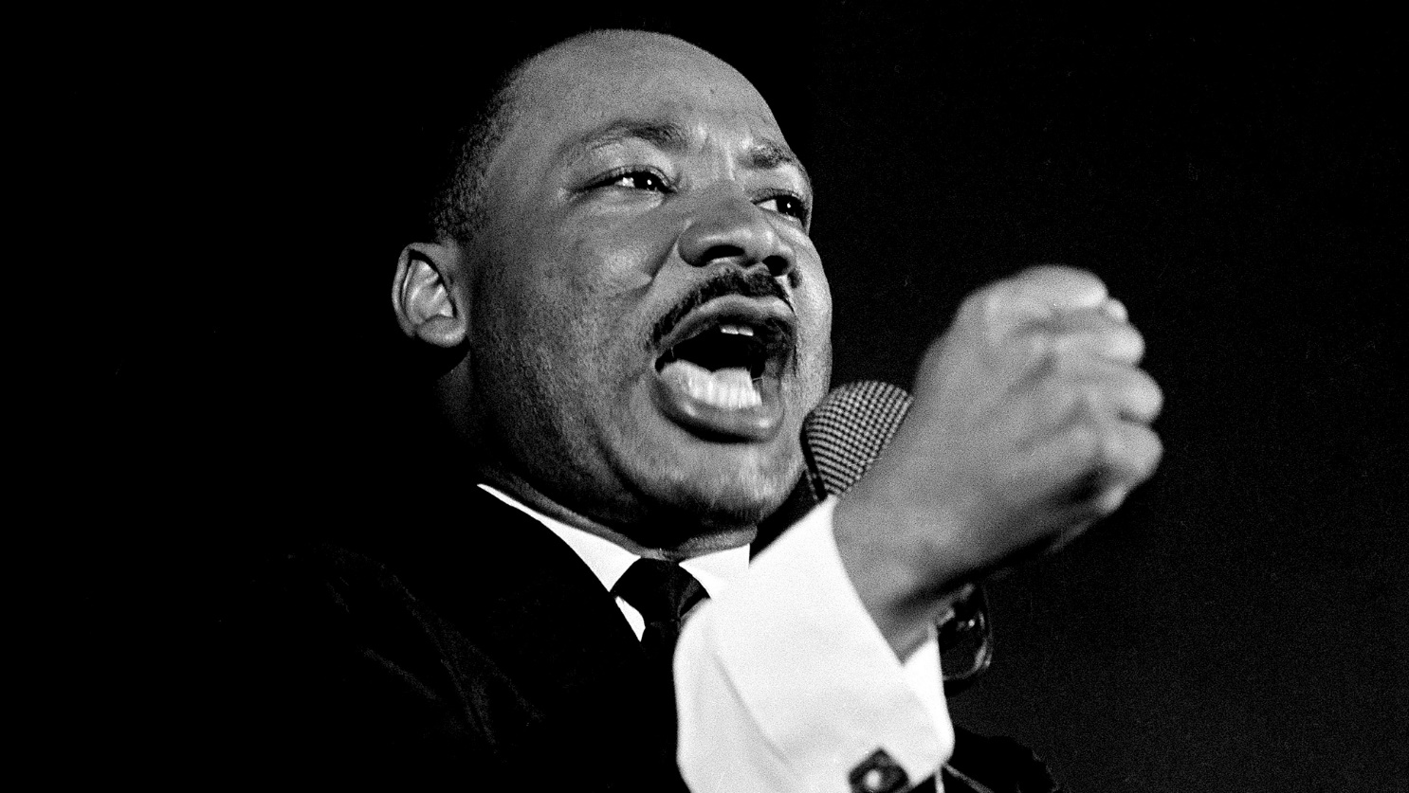
Dr.Martin Luther King,Jr
When we rise and go to the bath, a cake of soap is handed us by a Frenchman, a sponge is handed us by a Pacific Islander, a towel by a Turk, our underclothes by an American or Englishman. We go down to breakfast, our tea is poured out by a Chinese. Our toast we accept at the hands of an English speaking farmer, not to mention the baker. We are indebted to half of the world before we finish breakfast. - Dr. Martin Luther King, Jr.

Slide 4
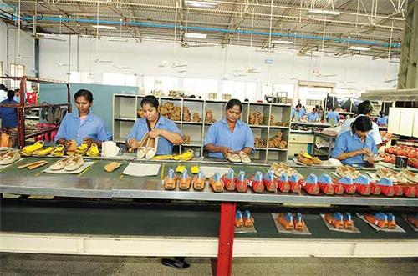
Trade makes everyone better off
Trade is the voluntary exchange of goods and services between two or more parties

Slide 5


Trade makes Everyone better off

Slide 6
Trade
From Individual- Household-Firms- country point of view
Society A | Society B
Agriculture production | Agriculture, tomatoes
Rice, potatoes and onions | Weaving and house making
Making utensils and pots | Traditional herbs

Slide 7
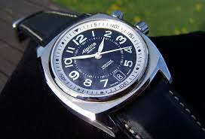
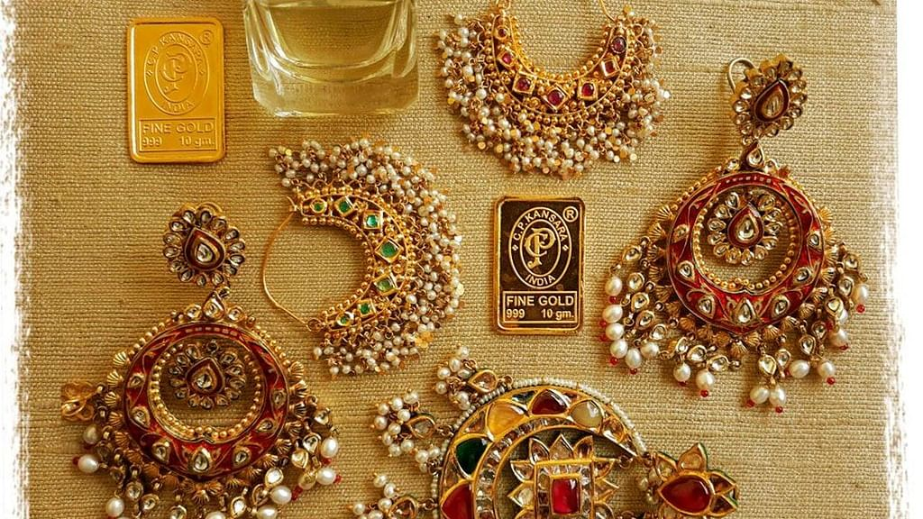
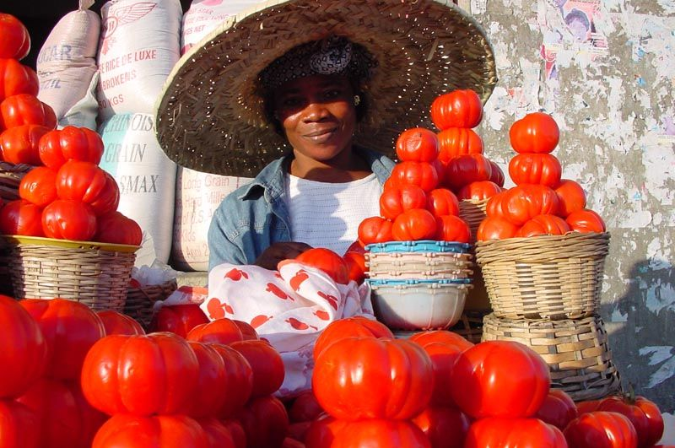
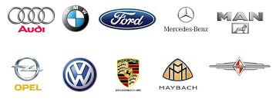

Slide 8
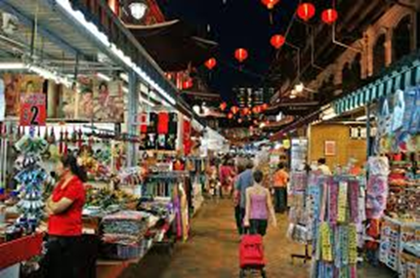
Markets are good way of organising economic activity
Markets were bring buyers and sellers together to exchange goods and services.

Slide 9
Aalsmeer Flower Auction Market
It’s the largest Flower Auction market in the world.
The Aalsmeer Flower Auction building is the fourth largest building by footprint in the world, covering 518,000 square metres (5,580,000 sq ft; 128 acres).
Flowers from all over the world —Europe, Israel,Eucador, Colombia,Ethiopia,Kenya, and other countries — are traded every day in this gigantic building.
Around 43 million flowers are sold daily.
The auction is set up as a Dutch Auction in which the price starts high and works its way down.

Slide 10
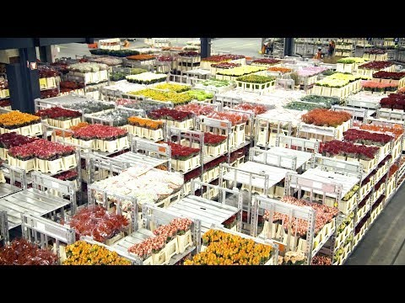

Slide 11
Markets are good way of organising economic activity
Main characteristics of market economy
Individuals pursue their own self interest , buying and selling what seems best for themselves and their families.
People respond to incentives. Other things being equal sellers seek high prices while buyers seek low prices.
Prices are set in open markets in which suppliers compete to sell to potential buyers.
People earn their incomes by selling their services to those who wish to use them-their labour services-or by selling the services of the property that they own them.

Slide 12
Free markets contain many buyers and sellers- all of them interested primarily in their own well being.
Adam Smith is a father of Economics.
“Households and firms interacting in markets as if they are guided by Invisible hands”
Prices are the instrument with which the invisible hand directs economic activity.
When the government prevents prices from adjusting naturally to supply and demand ,it impedes the invisible hand’s ability to coordinate the decisions of the households and firms that make up the economy.

Slide 13
How government can sometimes improve market outcomes.
If the invisible hand of the market is so good, why do we need government?
Property rights : the ability of an individual to own and exercise control over scarce resources.
Market failure : a situation in which a market left on its own fails to allocate resources efficiently.
Externality: the impact of one person’s action on the well being of a bystander.
Market power: the ability of a single economic actor or small group of actors to have a substantial influence on market prices.

Slide 14
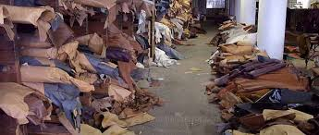
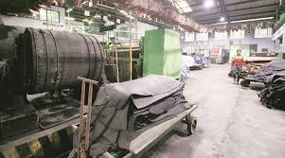
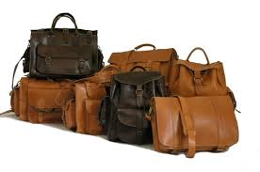
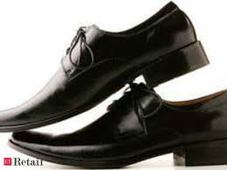

Slide 15
Case of Vellore Leather Industry
The Vellore Citizens Welfare Forum filed a public interest petition under Article 32 of the Constitution of India against large-scale pollution of the soil and water caused by a number of tanneries and other industries in Tamil Nadu.
Considering the vital importance of the leather industry to generate revenue for the state and employing thousands of workers, the tanneries and other polluting industries in the State of Tamil Nadu were persuaded for many years to control the pollution generated by them. They were given option either to construct common effluent treatment plants (CETP) for a cluster of industries orto set up individual pollution control devices.

